Slide 1

IEEE TRANSACTIONS ON ULTRASONICS, FERROELECTRICS, AND FREQUENCY CONTROL, VOL. 65, NO. 7, JULY 2018
Ultrasound Open Platforms for Next-Generation Imaging Technique Development
Enrico Boni, Member, IEEE, Alfred C. H. Yu, Senior Member, IEEE, Steven Freear, Senior Member, IEEE, Jørgen Arendt Jensen, Fellow, IEEE, Piero Tortoli, Senior Member, IEEE
Reporter: Jinhui Chen

Slide 2

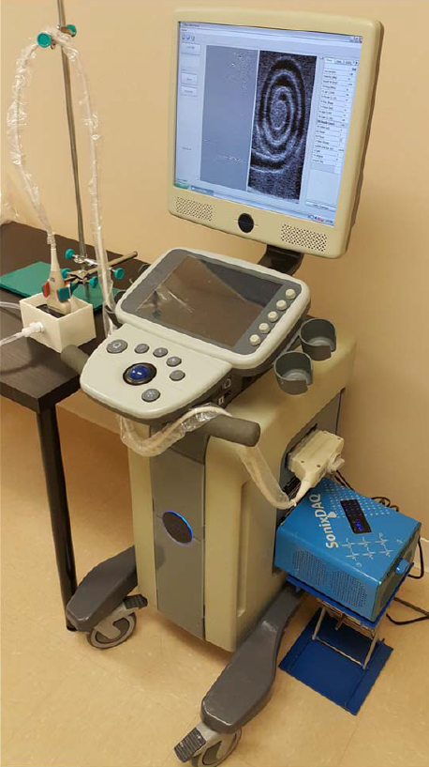
Outline
Introduction
Historical review of Ultrasound Open Platforms
Architecture of Open Platforms: Software-Based Platforms
Architecture of Open Platforms: Hardware-Based Platforms
Open Platforms With Extended Number of Channels
Discussion
Conclusion

Slide 3
Introduction
Ultrasound imaging has enjoyed tremendous success as a real-time imaging modality for bedside diagnostics
The operations of clinical ultrasound scanners cannot be readily reconfigured due to various hardware constraints and proprietary barriers imposed during the embedded system design process
A few ultrasound scanners with add-on research interfaces have been developed by clinical system manufacturers in the early 2000s
In recent years, ultrasound research scanners that are truly based on the open platform concept are actively being developed to more effectively facilitate the practical evaluation of new ultrasound imaging methods.

Slide 4
Historical review of Ultrasound Open Platforms
Early Development Efforts (1970s-1990s)
1980s: The first digital SA system using an array probe had a single channel in both TX/RX, its received response digital reconstruction by dedicated hardware
1991: The first research system for fully digital acquisition was used in conjunction with a BK Medical single-element rotating probe
1998: The combination of digital acquisition and array probe TX was realized in the late 1990s using RX multiplexing

Slide 5
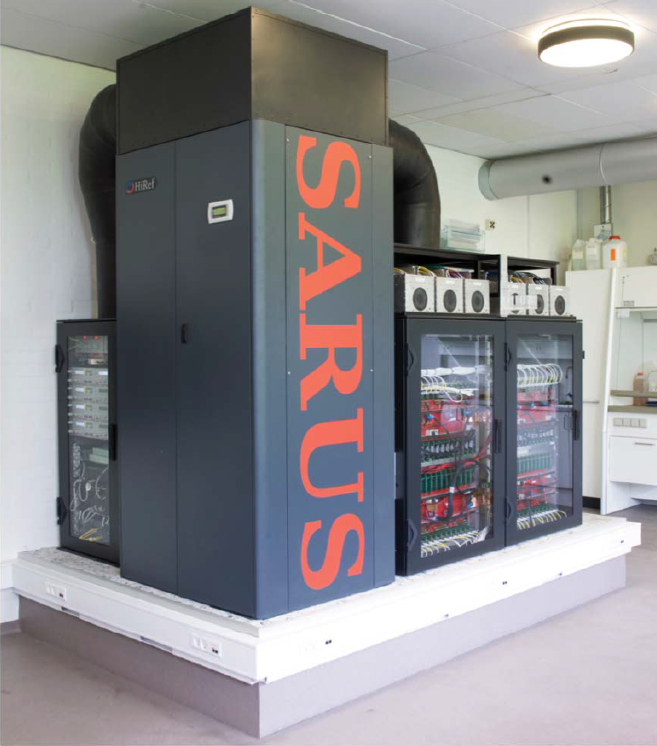
Historical review of Ultrasound Open Platforms
Array Systems With Full TX and RX Control
2005: The first OP with real-time TX and RX control of the entire array was the Remotely Accessible Software configurable Multi-channel Ultrasound Sampling (RASMUS) system
waveforms could be transmitted on up to 128 channels in parallel,
data could be sampled at 40 MHz and 12-bit resolution for 64 channels in parallel and stored in 16 GB of RAM.
2010: The second generation of the Danish system called SA realtime ultrasound system (SARUS)
can send out arbitrary coded signals on all 1024 channels and can receive simultaneously on all channels,
data can be stored in the 128-GB RAM, 320 FPGAs in the system.

Slide 6
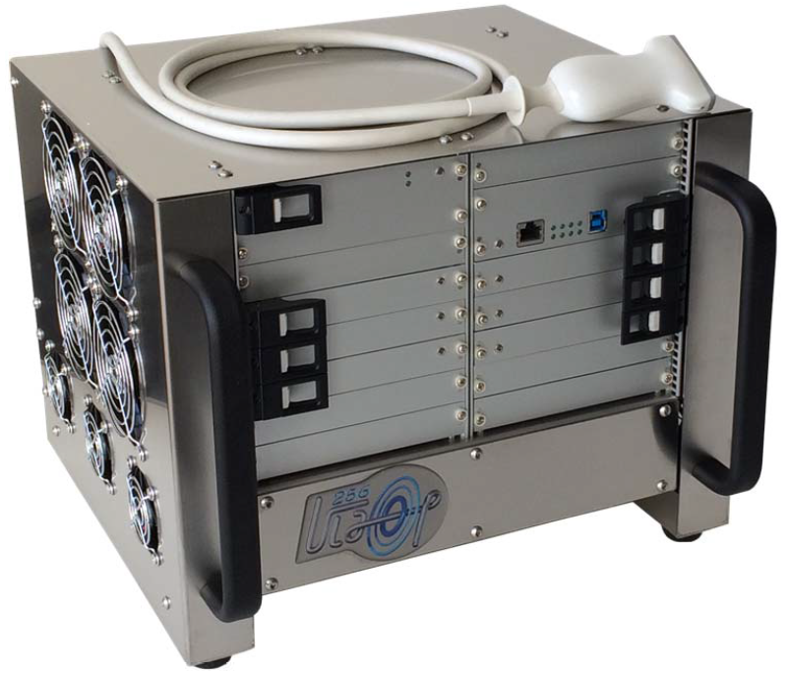
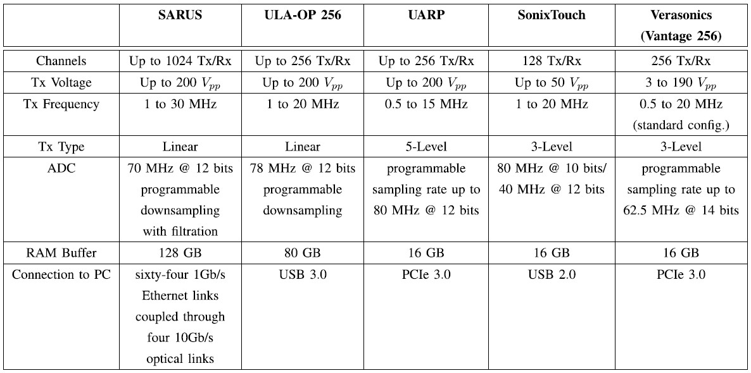
Historical review of Ultrasound Open Platforms
Open Platforms With Transportable Size
Commercial Systems for Research Purpose

Slide 7
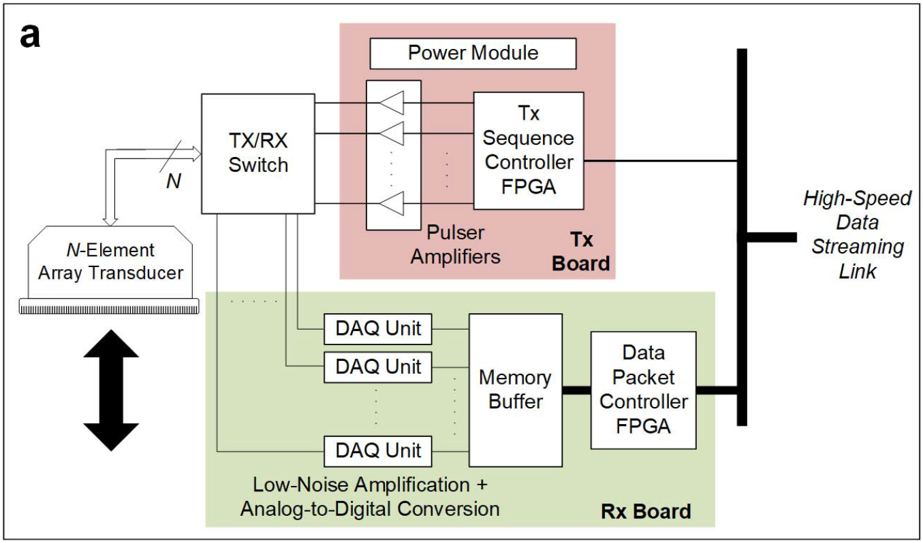
Architecture of Open Platforms: Software-Based Platforms
OP scanners that implement data processing routines through computer programming
Front-End Electronics

Slide 8
Architecture of Open Platforms: Software-Based Platforms
Data Streaming
software-based OPs do not have a hardware beamformer, nor on-board computing devices
all the acquired channel data are fed to the computing back-end for processing
the data handling strategy necessitates the use of a high-speed data streaming link
data transfer links with high bandwidth are typically deployed in software-based OPs:
multiple PCIe links
PCIe hardware switch is deployed to facilitate the direct streaming of data packets to back-end computing devices

Slide 9
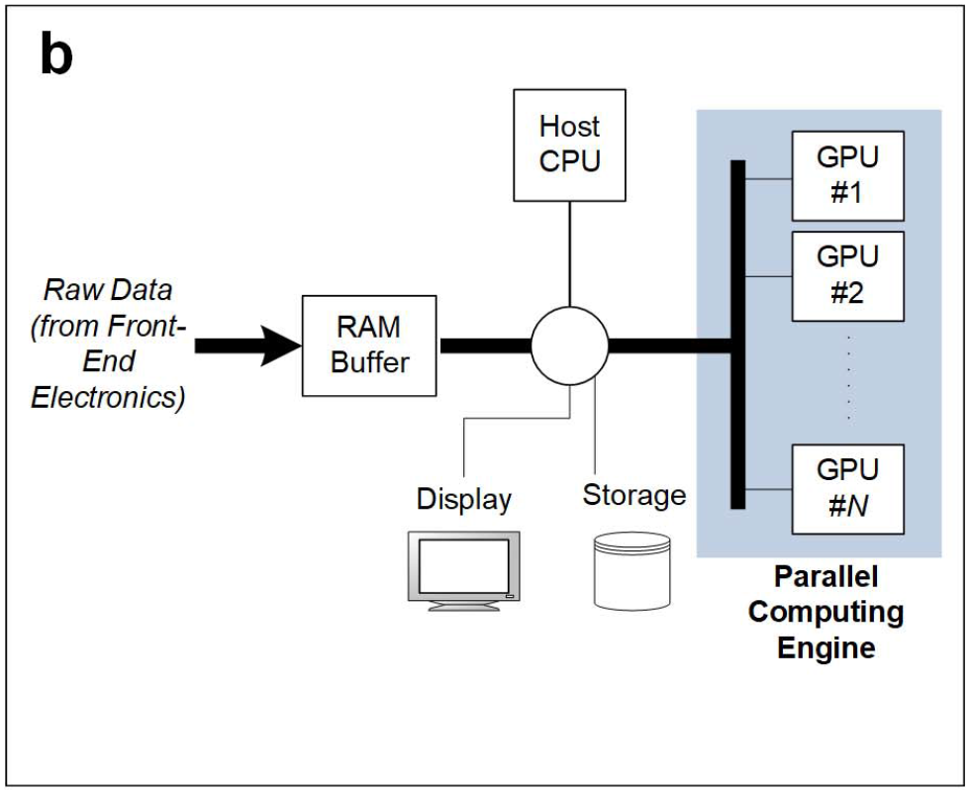
Architecture of Open Platforms: Software-Based Platforms
Back-End Computing Engine
responsible for executing the entire signal processing chain that regards raw channel data frames as its input.
GPU has been leveraged as an enabling technology to facilitate high-throughput parallel processing of raw data samples

Slide 10
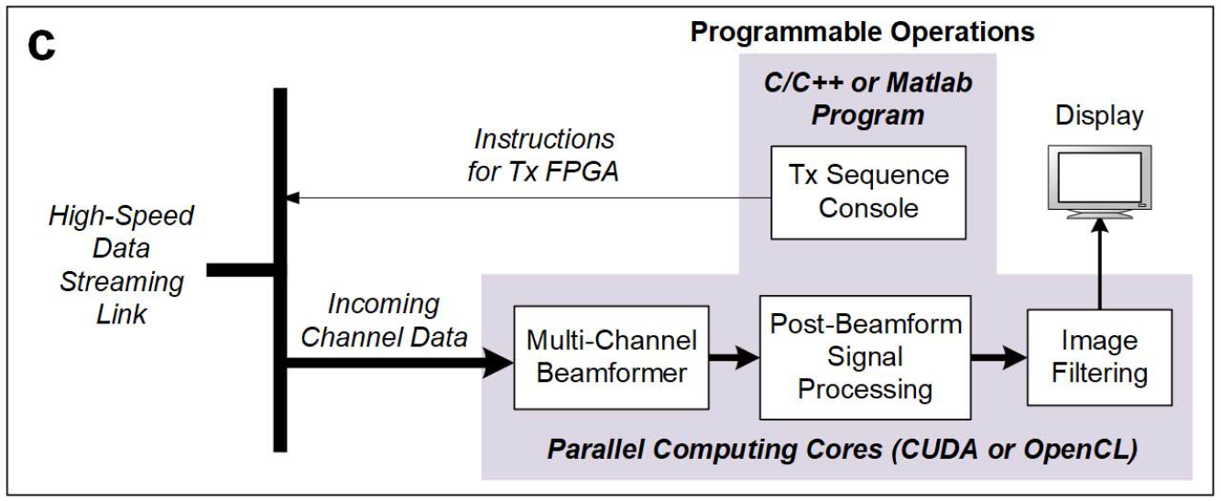
Architecture of Open Platforms: Software-Based Platforms
Programmability of System Operations

Slide 11
Architecture of Open Platforms: Software-Based Platforms
Software-based OPs offer researchers the convenience of using C/C++ or MATLAB to prototype new signal processing methods that work with raw channel data.
The savings in development time effectively serve to accelerate the pace of development for new ultrasound imaging techniques.

Slide 12
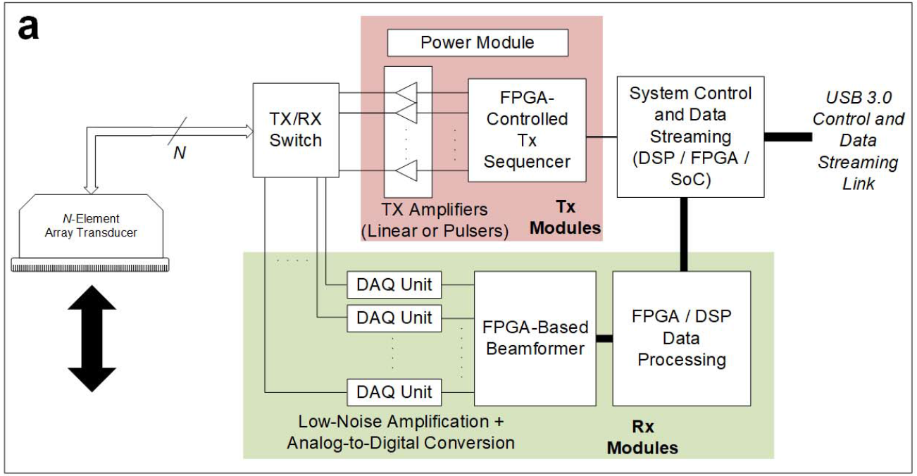
Architecture of Open Platforms: Hardware-Based Platforms
OP scanners that realize data processing via on-board computing hardware such as FPGA, digital signal processor (DSP), and system on chip (SoC)
General System
Organization

Slide 13
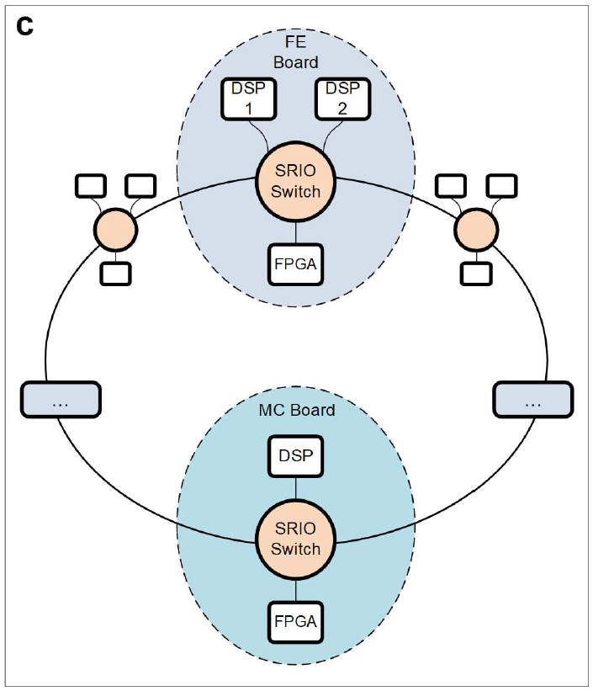
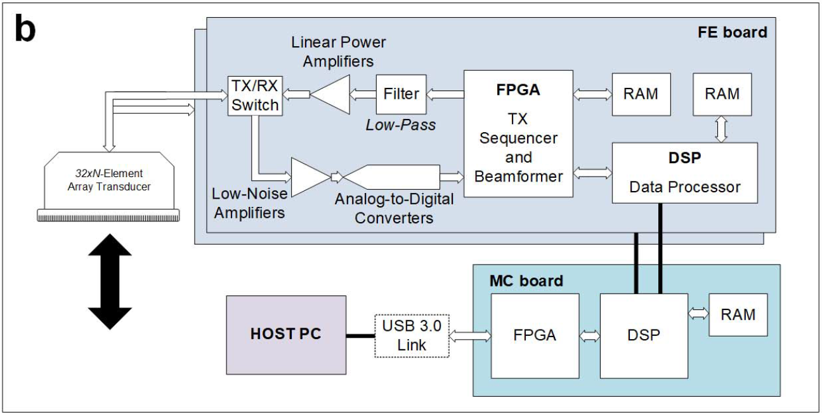
Architecture of Open Platforms: Hardware-Based Platforms
Hardware Architecture
A hardware-based OP may be devised using a modular design approach to effectively facilitate the scaling of system complexity in terms of both PCB design and programmability.

Slide 14
Architecture of Open Platforms: Hardware-Based Platforms
Data Acquisition and On-Board Processing
On the RX side, the raw channel echoes are relayed to four 8-channel ultrasound FE ICs, where they are amplified and are digitized
The digitized data streams are sent to the FPGA and are stored in a RAM storage buffer
Each FE board during its TX operation would generate 32 independent arbitrary signals
After FPGA beamforming, the output data may be passed to the two on-board DSPs
The FPGA on each FE board can be programed to perform different beamforming strategies on 32 channels
DSPs are leveraged to perform coherent compounding of RF data or demodulate the RF data into quadrature channels, and then perform low-pass filtering and down sampling to derive the corresponding baseband data
Each FE board’s processor output is sent to the MC board through the ring topology
MC board’s DSP would correspondingly sum the intermediate data samples from different FE boards to obtain the final beamformed (or baseband) data sample for each pixel position in the image grid

Slide 15
Architecture of Open Platforms: Hardware-Based Platforms
Programmability of System Operations
Similar to software-based OPs, the TX and RX operations of hardware-based OPs may be programed by the user
For RX data processing, the user can configure real-time code modules that are provided within the firmware package
The configuration of these prebuilt modules is described by text files that define, for each PRI, the data to be elaborated and the parameters related to the instantiated module.

Slide 16
Open Platforms With Extended Number of Channels
The investigation of 3-D imaging and advanced beamforming necessitates the development of research systems with a very high channel count (>256 channels).
Standalone Systems
The first OP with more than 256 channels is the SARUS scanner which comprises 1024 independent TX and RX:
All 1024 channels can be used simultaneously or the system can be split into four independent system, which can be used at the same time on four experiments

Slide 17
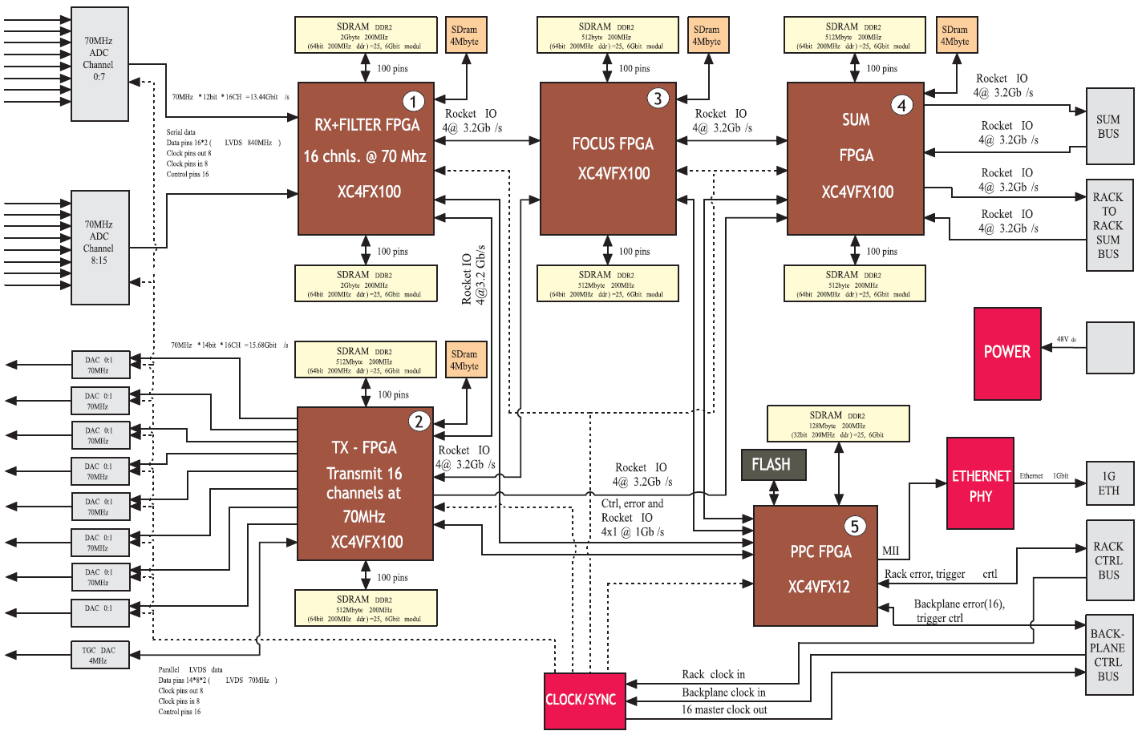
Open Platforms With Extended Number of Channels
Block diagram of the FE board in the SARUS system

Slide 18
Open Platforms With Extended Number of Channels
Composite Platforms via Multisystem Synchronization
A possible extension of channel count could be achieved by the use of multiplexers interposed between the scanner and the probe
One viable alternative is to connect together more systems in attempt to control all array elements concurrently.
ULA-OP 256 was designed with embedded synchronization capabilities. One master system can directly feed up to four slave systems with proper acquisition clock and synchronization signals
Such a composite platform assembly strategy unavoidably brings synchronization issues, since forcing different discrete systems to run on the same clock is not trivial

Slide 19
Discussion
General Comparison of Open Platforms
Important technical attributes:
1) Its TX operations should be programmable on a perchannel basis.
2) Prebeamform RX data should be accessible over all transducer channels, and a significant amount of RAM is available to store the data samples from multibeat acquisition.
3) Abundant computing resources should be included to allow real-time implementation of new data processing methods.
These attributes are nowadays included in either hardware- and software-based OPs.

Slide 20
Discussion
General Comparison of Open Platforms
Open Platforms | Required knowledge | Real-time | Important feature
Software-based OPs | work with since their user-level programing environment, does not require knowledge of low-level hardware description languages | the design of parallel processing kernels requires some level of craftsmanship in order to optimize their processing performance | A important feature shared by different types of ultrasound OPs is that they possess tens and hundreds of gigabytes of RAM to store full RF data frames over multiple heart beats
Hardware-based OPs | must be proficient in both low-level programming languages，high-level languages and system architecture | suited for real-time applications, because the data transfer issue is reduced considerably

Slide 21
Discussion
Future Trends of Open Platforms
The demand for more advanced OPs with an extended number of channels is poised to grow
Faster data transmission technology is well possible to be adopted in next-generation OP systems
As more convoluted imaging algorithms are being developed, it would be worthwhile to pursue a hardware–software hybrid computation approach that combines the strengths of GPU, FPGA, and DSP to implement these algorithms in real time
System design partitioning will likely become a significant engineering topic of interest for real-time realization of the next-generation ultrasound imaging methods

Slide 22
Conclusion
Thanks to the increasing maturity of OP ultrasound scanners, the research community is now entering another golden age where researchers are actively proposing a variety of new imaging methods and algorithms
Rapid progress in electronics and computer science is driving the next wave of OP development with high-speed, small-size ICs for both acquisition and processing, a significant amount of RAM resources as well as high-level programming of sophisticated TX–RX strategies
It is well anticipated that the performance of upcoming OPs will further increase in terms of processing power, flexibility, and ease of programming
In turn, these next-generation OPs will undoubtedly accelerate the pace of advancement in ultrasound imaging technology

Slide 23
THANKS!

